Slide 1
Parameter estimation
Probability and Statistics for Data Science
Part 3

Slide 2
How and why we estimate parameters

Slide 3
Probability vs statistics
Probability studies properties of random variables with known distributions and their parameters.
Statistics tries to infer parameters of distributions from data. That’s what we are going to do today.
But first, what these “data” really are – from a probabilistic point of view?

Slide 4
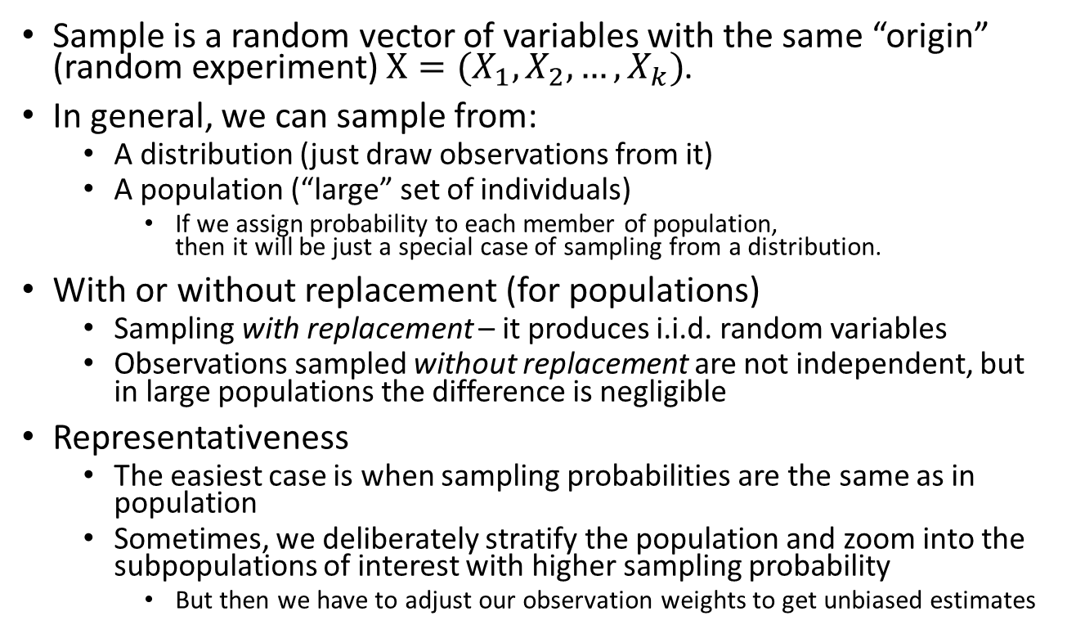
What a sample is
Notes:
We assume that there is some sort of distribution in the world. A sample is just a collection of random elements drawn from this distribution. If we assume the distribution changes throughout the sampel ,it may be useless to infer things about it- as the world has changed.
When we say we “believe” this is the case, it doesn’t mean we use exactly this. Fr example, if we have a true model, we can draw samples theoretically from this model. If we aren’t sure that it is the true model, we would sample from the population.
Usually the case is that we only have the population, and we want to infer things about such data.
We can also sample with repetition or replacement. In the card examples, we can say that we are not putting the card back (without replacement). The common case, is that we assume that the card is put back- has repetition. When the sample space is big, such as 1 million cards, the difference between replacement and iteration converges to the same thing.
Its also important to consider how represtnative a sample is. Usually, when wanting to calculate the probability of a symptom in a population, we want to sample people proportionally to the population. However, if…. Then we may want to sample more from the ill group, and give it more weight.

Slide 5
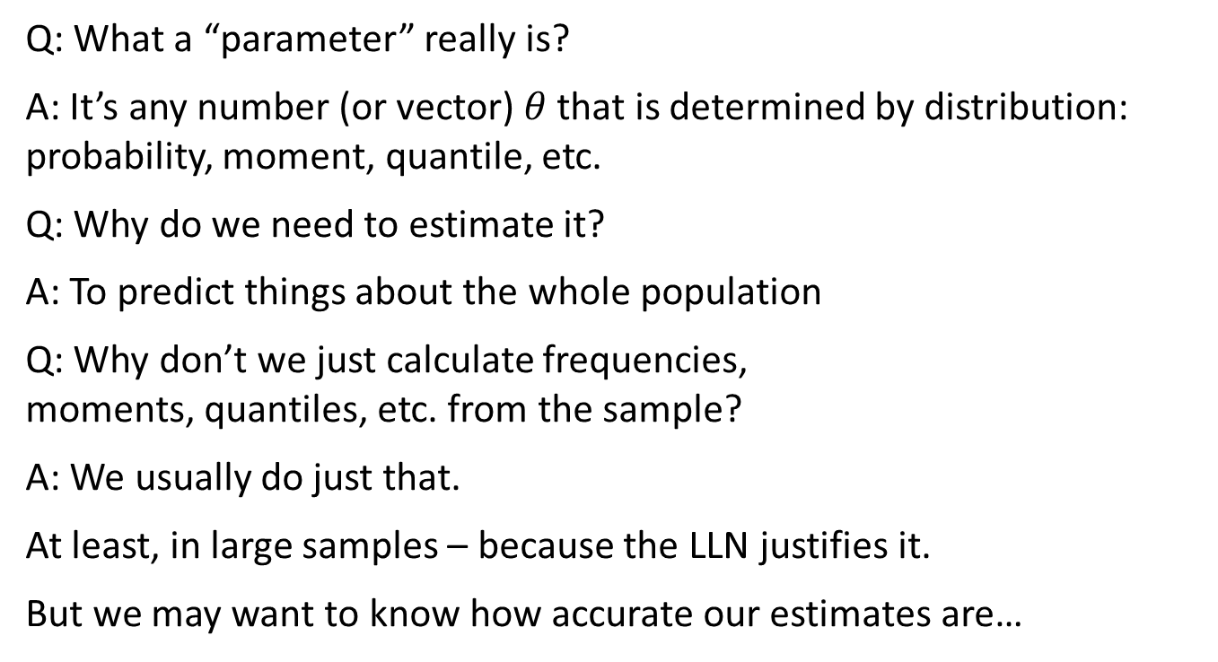
What a parameter is
Notes:
Paramter
When we say that the normal distribution has a mean, then the mean is a parameter– a number related to/defines our distribution. We can also have mu and sigma squared. In some cases, these parameters aren’t so straightforward. If we don’t have a closed form for the distribution, we can sample and keep our quantiles (?). Usually, we don’t think of these as paratmeres, rather statistics- still, they are parameters.
Why do we estimate them? For the specific case, we don’t know the mean and std of the normal distribution, only that there is a normal distribution. Some want to derive the numbers that would describe our specific case, and make an assumption that this applies to the whole population and not just the sample.

Slide 6
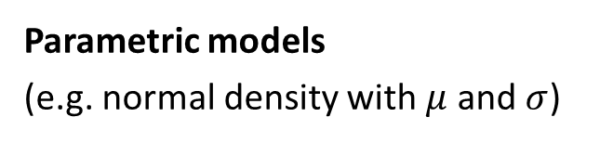
Do we need parameters at all?
Non-parametric models
(e.g kernel density estimate)
Data
Fixed number of parameters
Predictions
Data
Infinitely flexible representation
Predictions
Compact
Separate estimation and prediction
Have finite learning capacity
Extrapolate well
Usually store the whole training sample
May have infinite capacity
Usually have (hyper) parameters
Interpolate well
Notes:
The parametric model has a fixed number of parameters (we also do have parameters in non-parametric, its just that there it is not defined and fixed). By specifying my distribution, I am establishing the number of parameters. Its compact, and easy to calculate.
On the other hand, in real life, we don’t want to commit that we have distribution ‘x’, because we might just not know, or be very complicated. So instead of this uncertain commitment, we go the Non-parametric way, where we can keep a number of parameters based on the size fo the data. If the data is 1000 people, we can keep percentiles. If we have a million though, we can keep it…. If we were to commit ourselves to the normal distribution, we would always have five parameters, regardless of the amount of people.
With small samples, we prefer the parametric. Decision trees and other structure of the sort are non parametric- the tree grows along with the data, and we don’t know the form currently. Neural networks and linear regressions are paramtric– My data is, and has parameters x with form x.

Slide 7
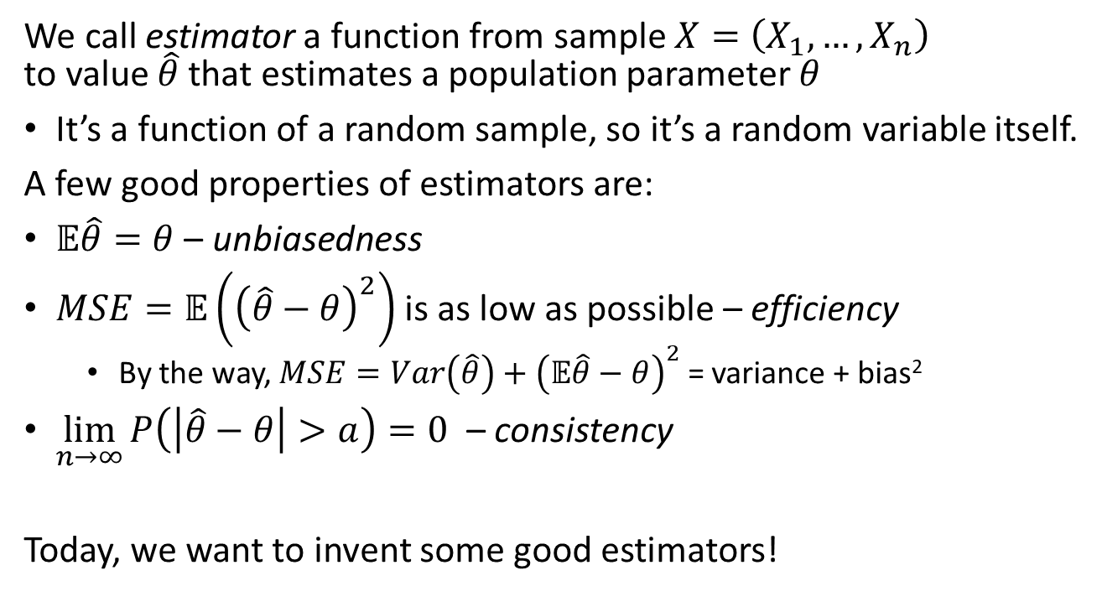
So what is a good way to estimate parameters?

Slide 8
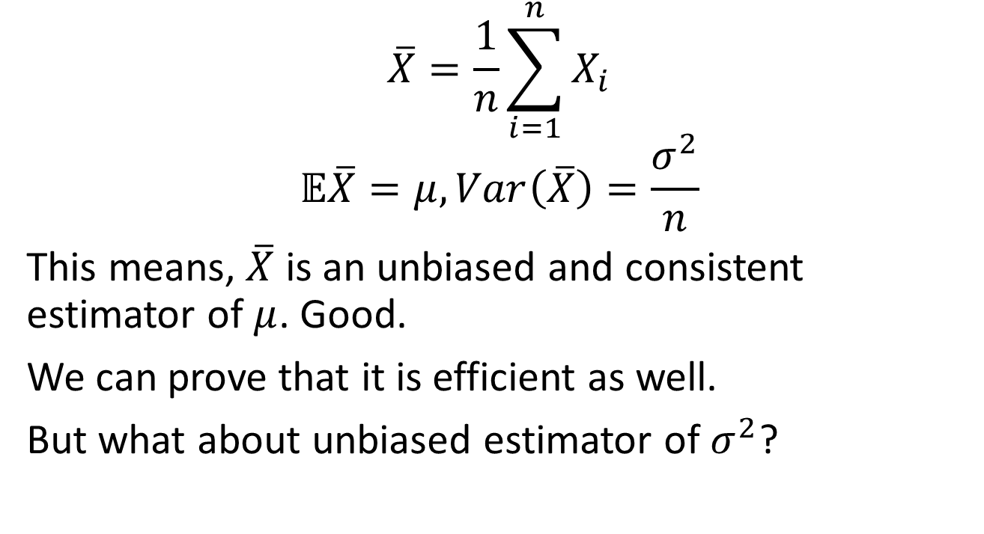
Sample mean, again
Notes:
We want to estimate the mean of a distribution, and we only got samples. The easiest thing to do, is to calculate the average and consider it as if it was a sample mean. With a large population, this would be true because of the law of large numbers, that the mean converges, and the probability that your sample mean would be far from the distribution tends to 0.
We want to know if our estimate is biased. The thing which is unbiased is the mean of….
There are cases however where we prefer biased estimators.

Slide 9
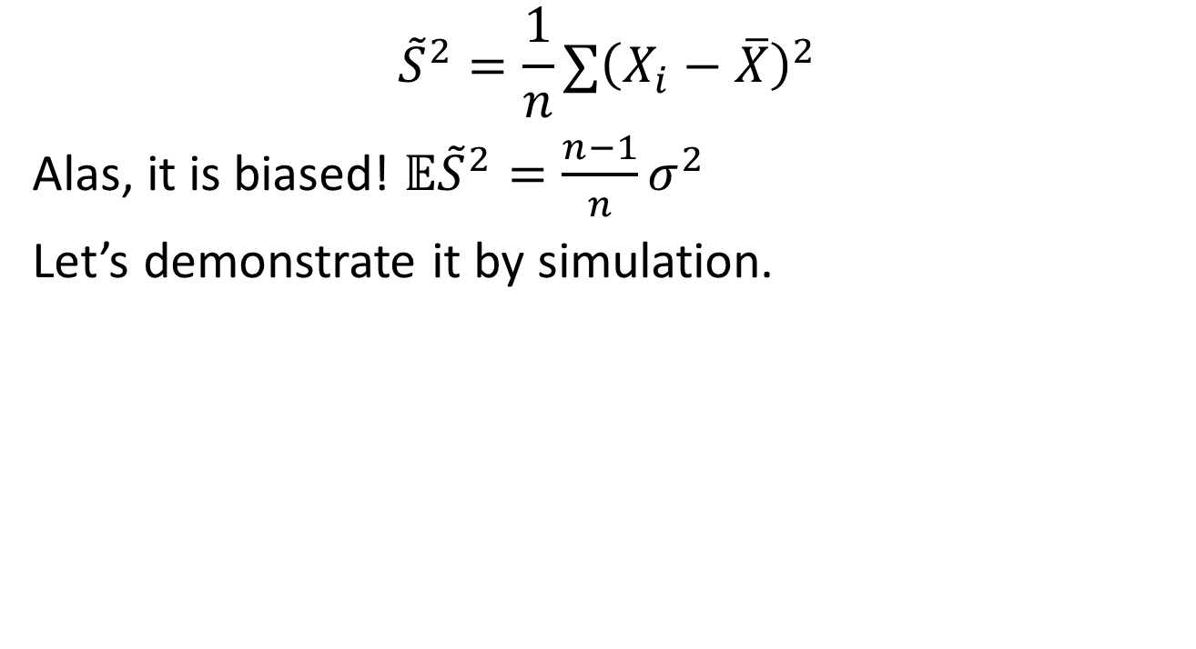
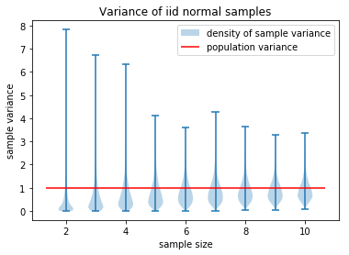
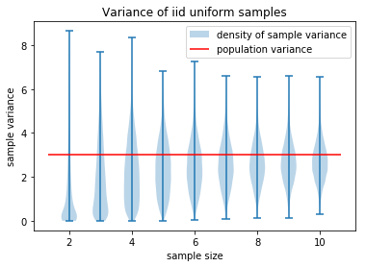
Sample variance
Notes:
Is the sample variance is biased, and should be scaled with n-1/n to make it slightly bigger (because it is only slightly biased). Why is there bias? By choosing ht mean (x bar), we choose the value of the Mu which reduces the spread of the data the most- but we didn’t actually know what Mu is.

Slide 10
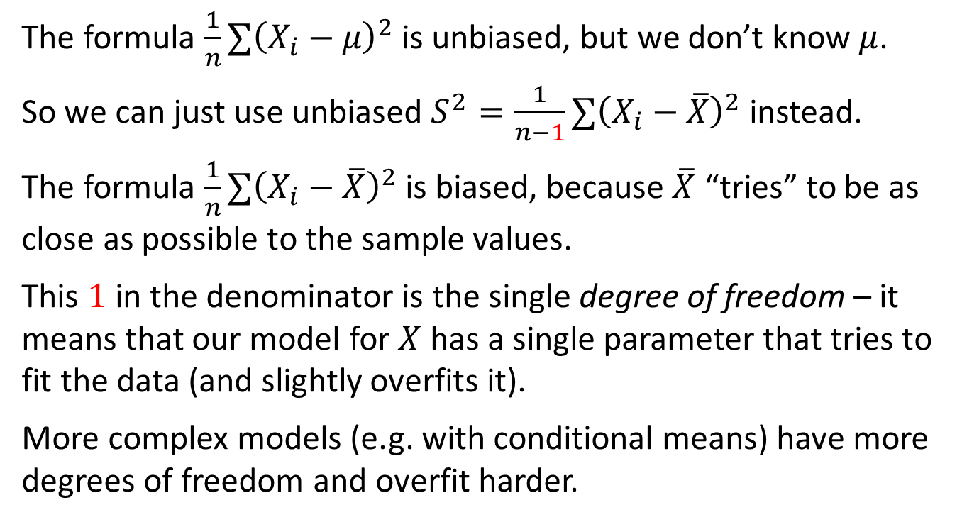
Sample variance, why?

Slide 11
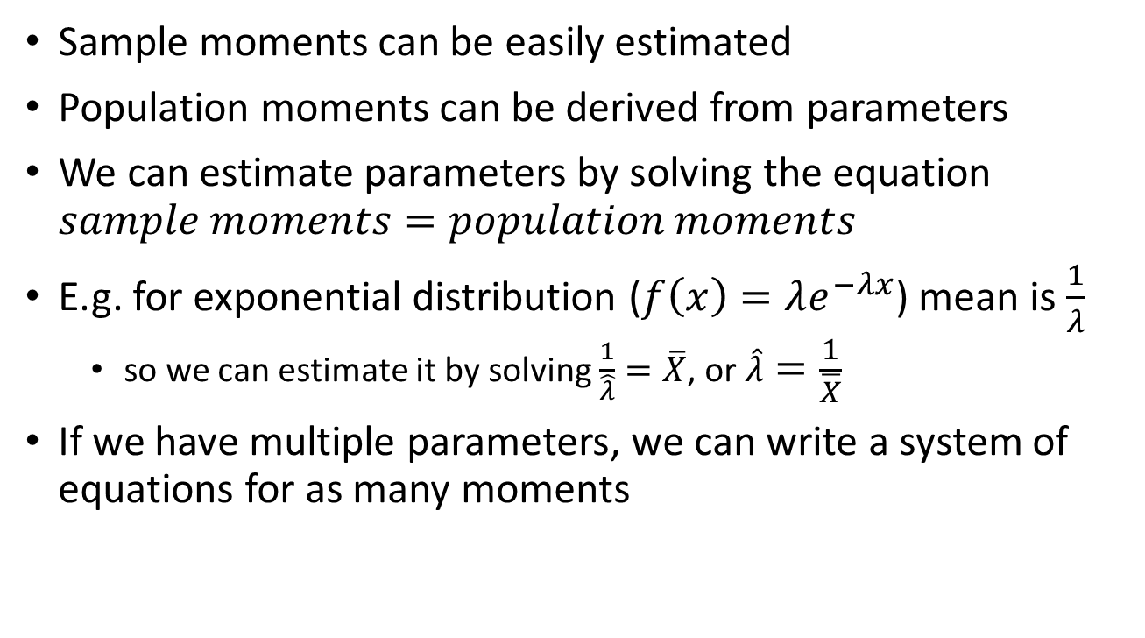
Method of moments
Notes:
If you are given the exponential distribution for example, which has one parameter, how do we estimate the parameter? Well, the first moment of the distribution, the mean, we would do the integration from 0 to infinity of the pdf X lambda. This would give us 1/lambda. (the analytical mean)
If we want to estimate the mean over any sample, we would compute the average. If you are lucky, these two numbers should be the same for a large N. (the empirical mean).
Why did we choose the mean though? Why don’t we choose to estimate the second moment? Then empirically we solve for the second moment, and compare. The reason is, because we won’t always get the same number, as it is a biased parameter.

Slide 12
Interval estimation

Slide 13
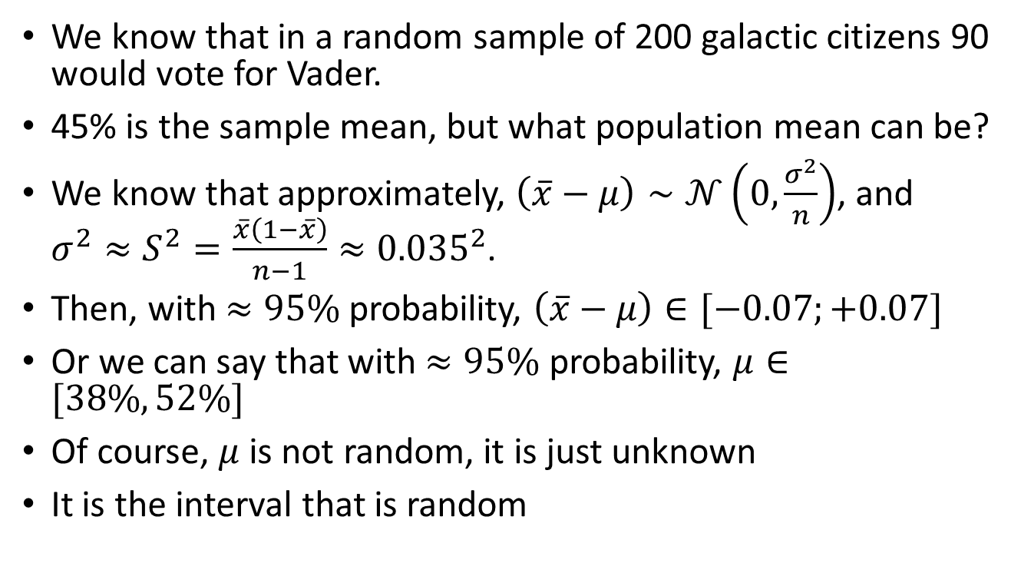
Example: the Darth Vader problem
Notes:
Suppose we have some estimation fo what our distribution is. Then we are not just interested in the value we will get, rather also the spread around the real value.
(0.45 * (1-0.45) / 199 = 0.035^2 ( sqrt(0.45 * (1-0.45) / 199) = 0.035 )
Sigma = 0.35.
2*sigma gives us the 95% confidence interval = -0.07, 0.07

Slide 14
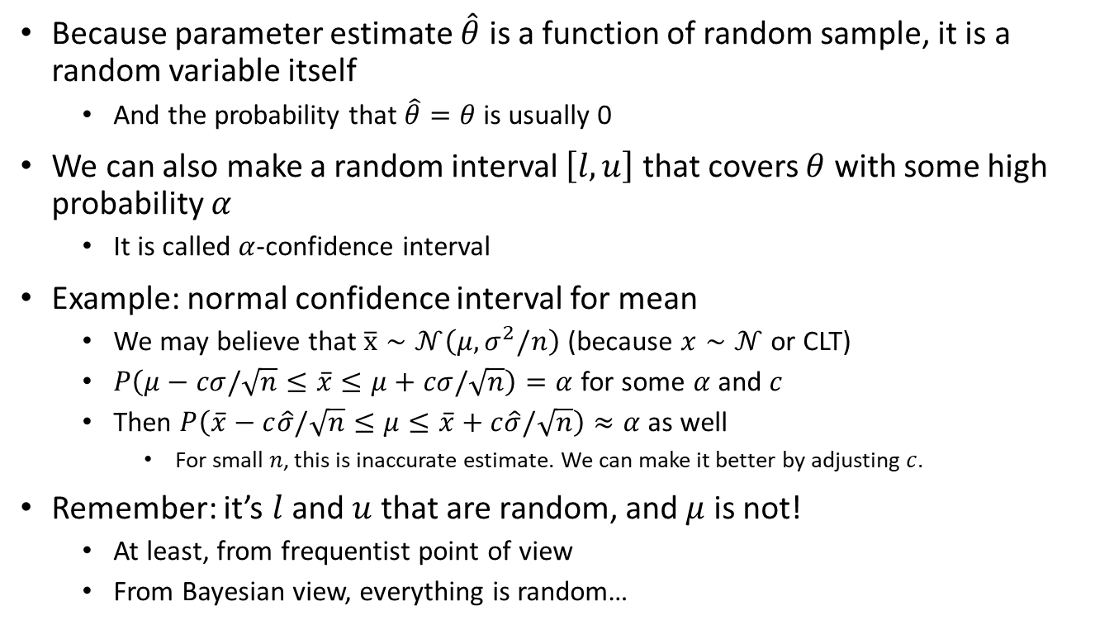
Confidence intervals

Slide 15
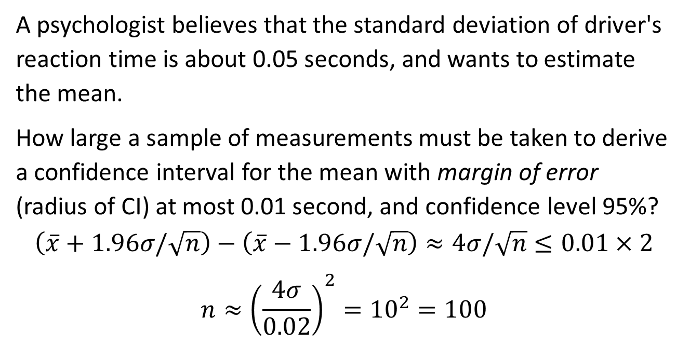
Sample size planning

Slide 16
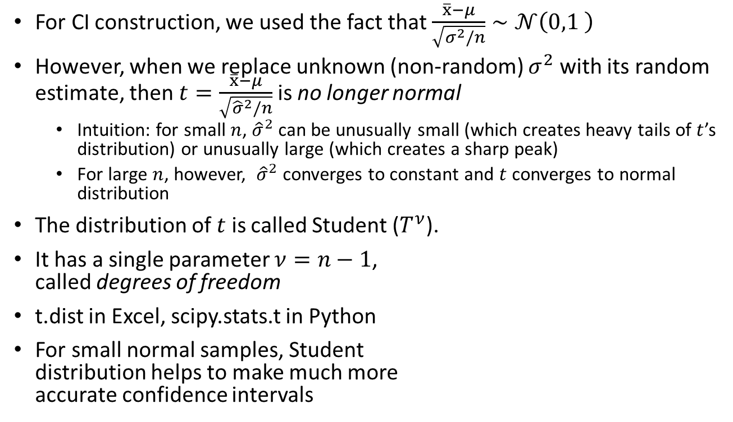
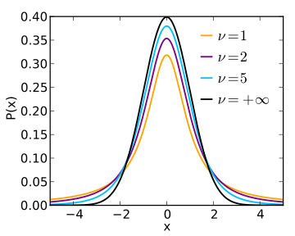
Student distribution
Notes:
Student Distribution = T distribution
The T Distribution is the distribution of…. IT could have been normal if we knew Mu, but it isn’t if we estimate Mu. If T is 5, then you see a big difference than the normal distribution. If T is say, 30, then it converges to normal.
In small samples this is often the case, such as in samples smaller than 100.
Degrees of Freedom is the size of the sample, minues the amount of parameters we estimated. Here it is 1, but in regression for example, we have D parameters, so it is N- D.
Suppose however, we knew the real mean. Then we wouldn’t have bias. However, whenever we do sample estimation, we don’t know the real mean, therefore we estimate the variance by a different estimation (the empirical average). If we did the calculation ,we would see that the distribution isn’t normal, rather something else (because it is just an estimated mean). When we have a large N, this concept is irrelevant. In a small N, because we estimated the mean, it will affect the shape of the distribution (seen in the graph).

Slide 17
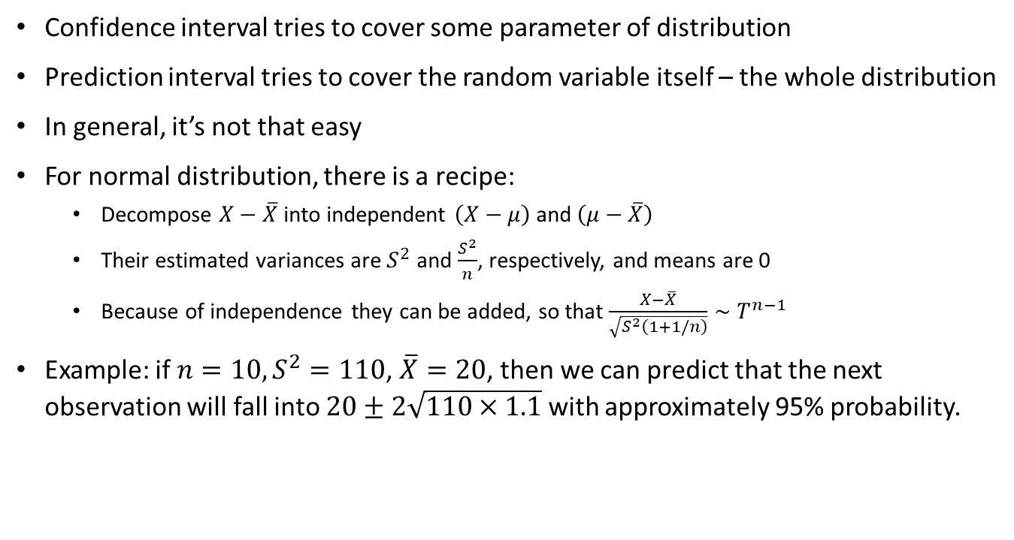
Prediction interval

Slide 18
The likelihood approach

Slide 19
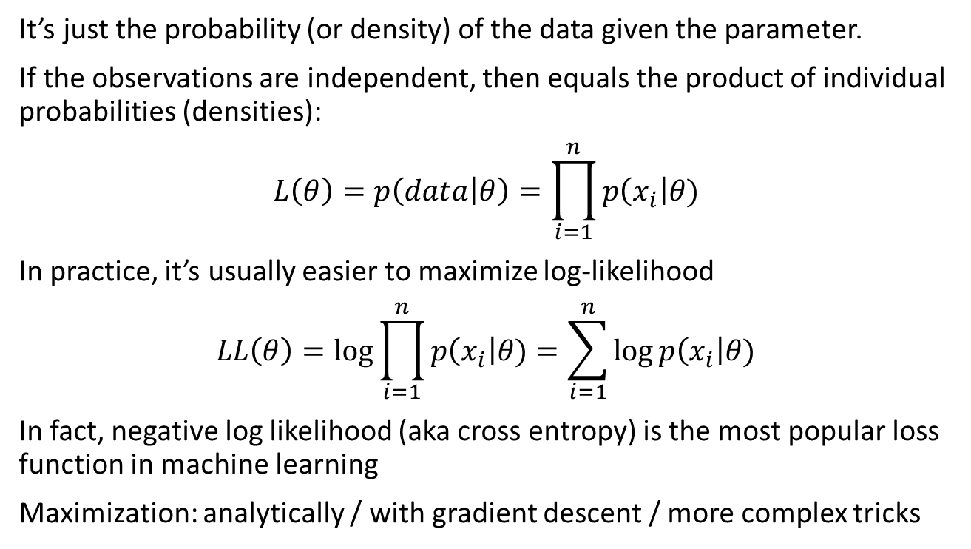
Maximum likelihood
Notes:
Suppose we have a distribution. It is a parameter. Now we have results (the sample). We can ask, what is the probability to get these results, given a certain value of the parameter. With a coin, (with 1 parameter of prob of getting heads), what is the prob of getting 50/100 if the coin has prob of 0.5? 0.6? 0.9? For each choice of the parameters, we would get a different prob to get this data. Which parameter would you choose, given a probability?
https://www.youtube.com/watch?v=XepXtl9YKwc&ab_channel=StatQuestwithJoshStarmer-- Statquest Explanation
https://www.youtube.com/watch?v=00krscK7iBA&ab_channel=MITOpenCourseWare – Examples/Math

Slide 20
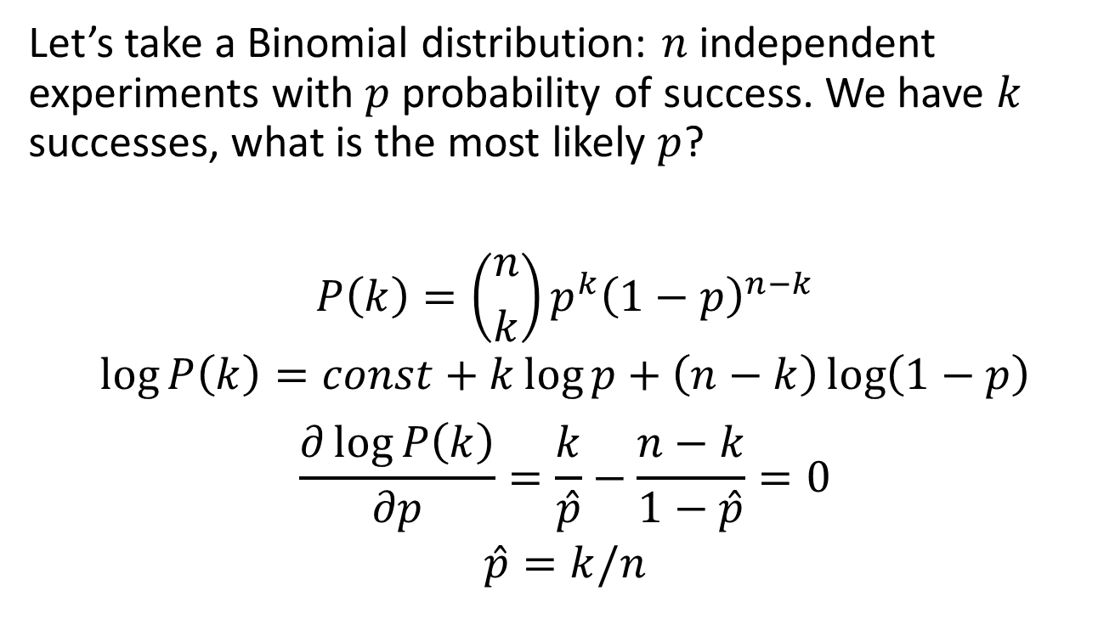
Maximum likelihood example
Notes:
P is the parameter. We want to estimate what p is. We take a sample of n tosses, and k results came out.
Here by the coin, the maximization of k/p is the intuitive answer, and makes sense.

Slide 21
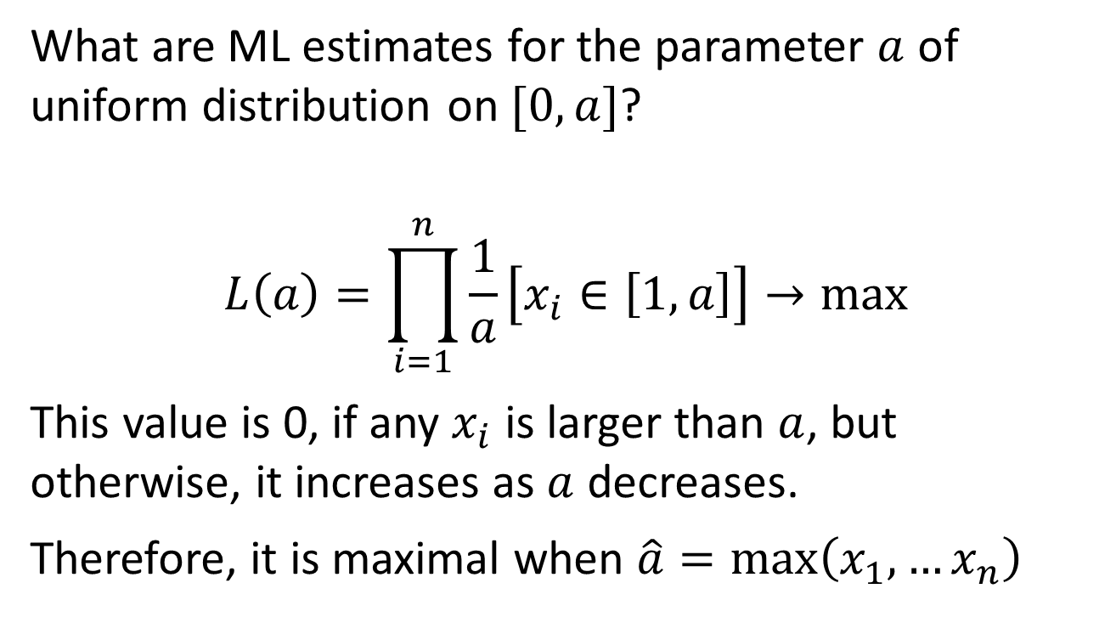
More ML examples

Slide 22
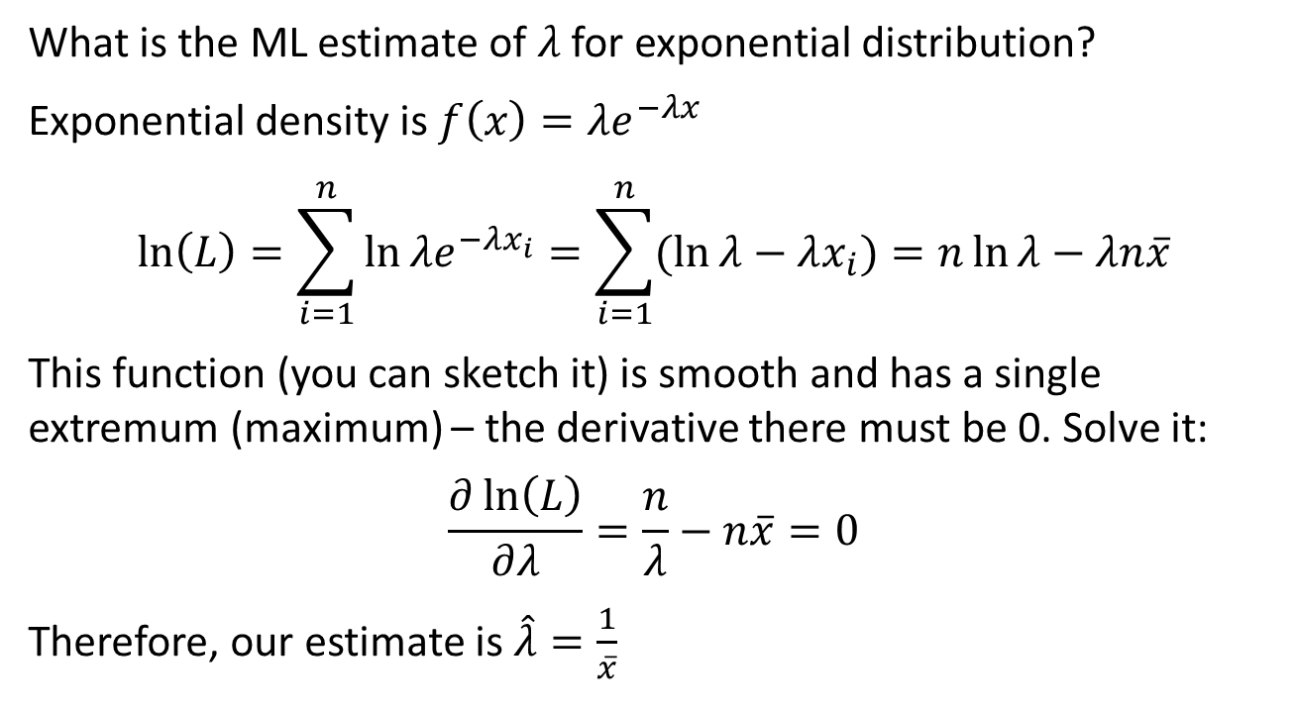
More ML examples

Slide 23
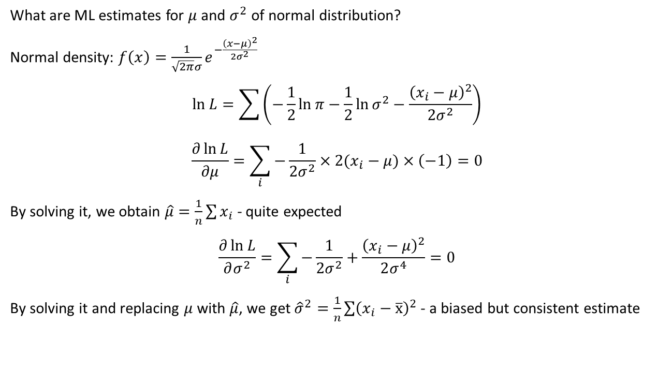
More ML examples

Slide 24
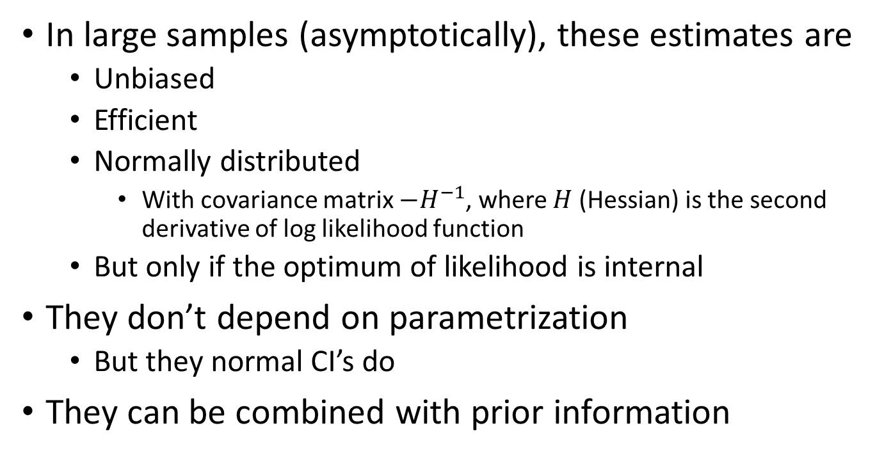
What’s so good about MLE

Slide 25
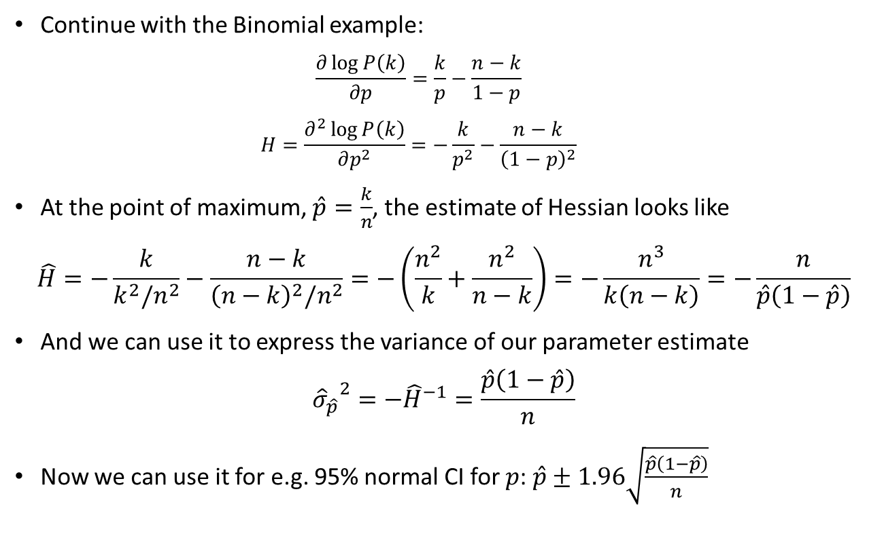
Example of MLE confidence interval

Slide 26
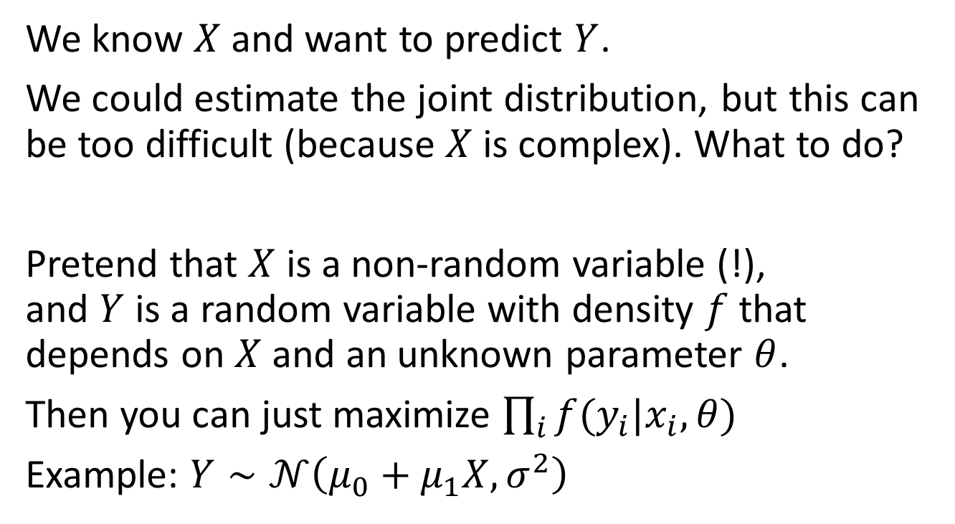
MLE for prediction problems

Slide 27
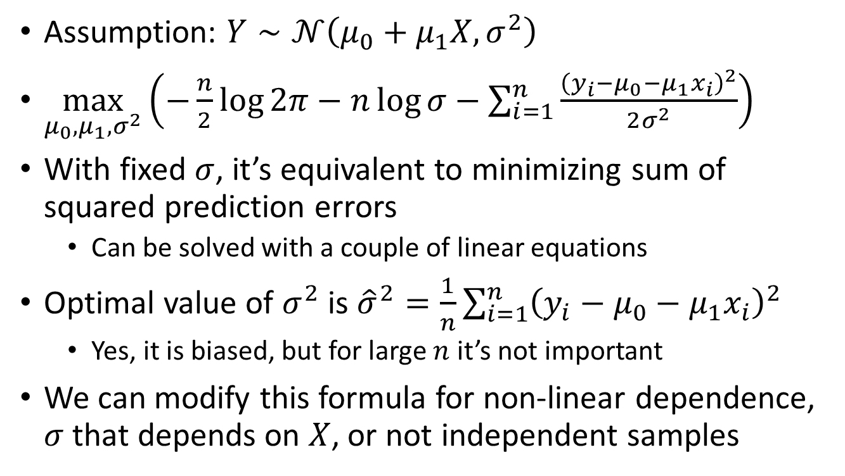
MLE for linear regression

Slide 28
Bayesian approach

Slide 29
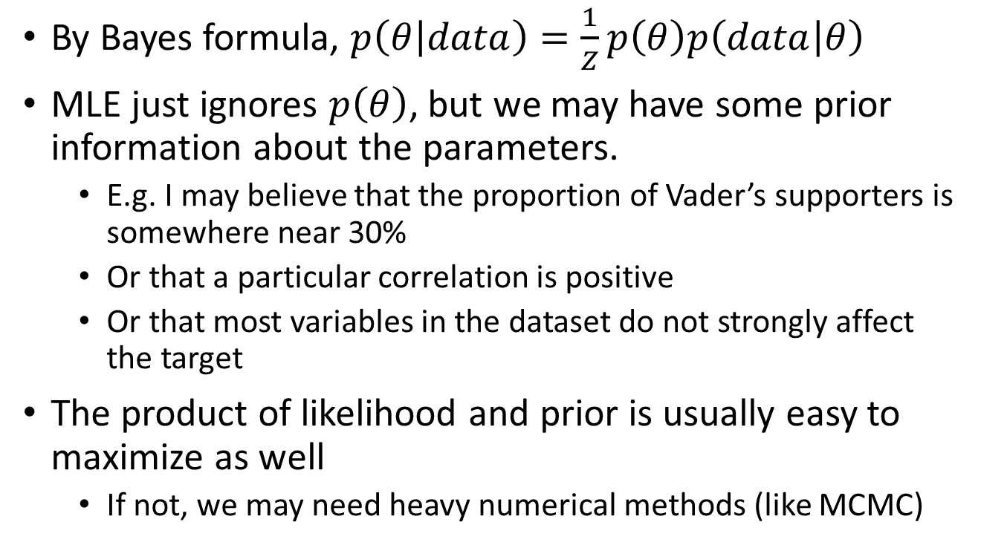
Prior information

Slide 30
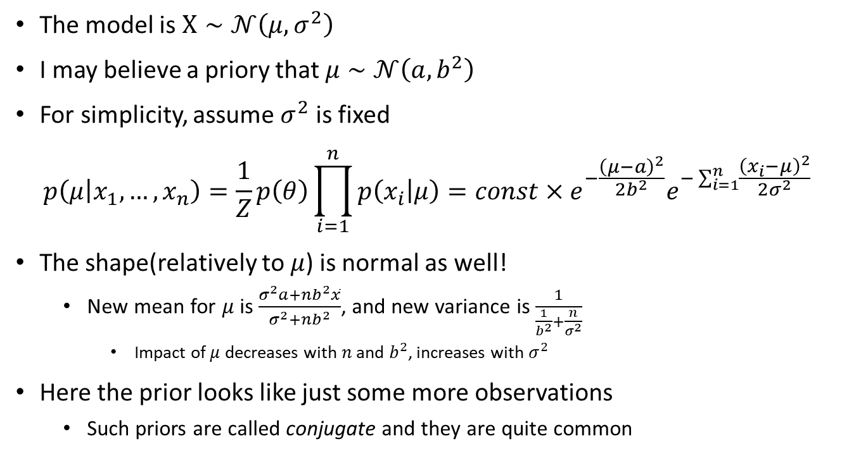
Example: prior mean

Slide 31
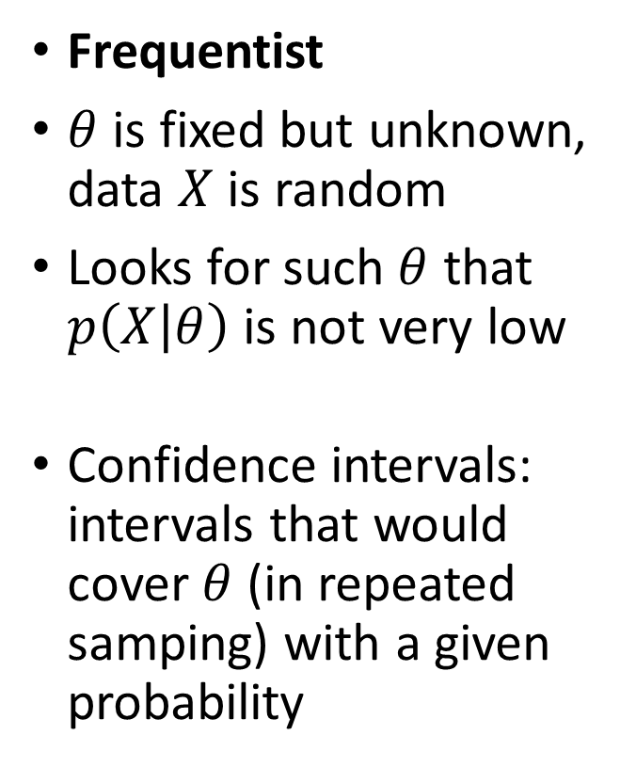
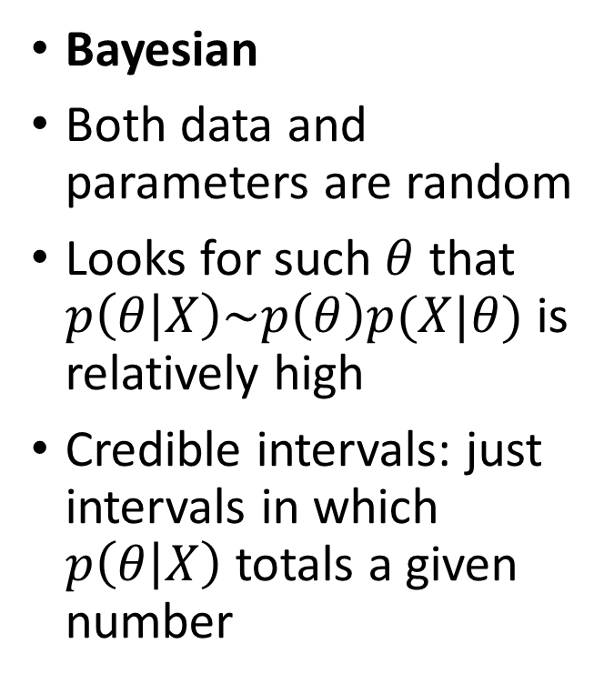
Bayesian vs frequenticst statistics

Slide 32
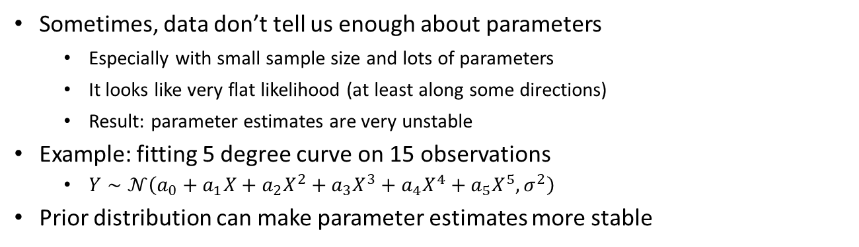
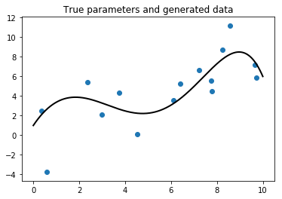
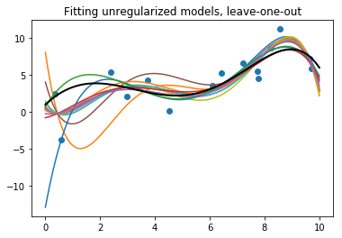
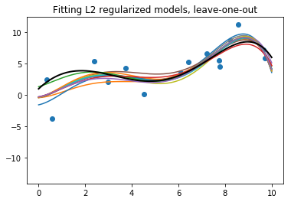
Overfitting

Slide 33
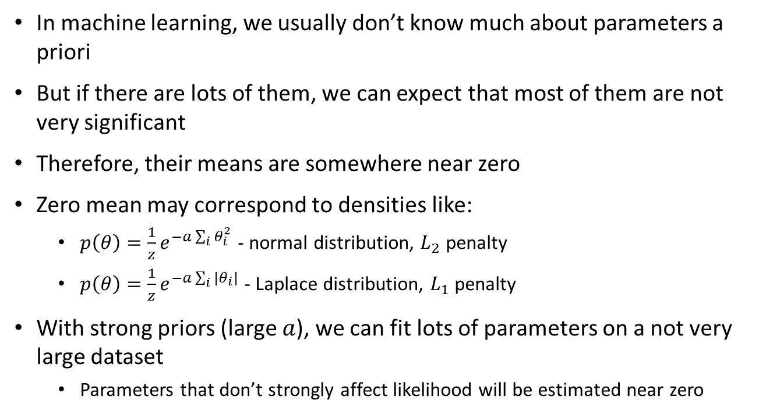
Regularization

Slide 34
Statistical tricks

Slide 35
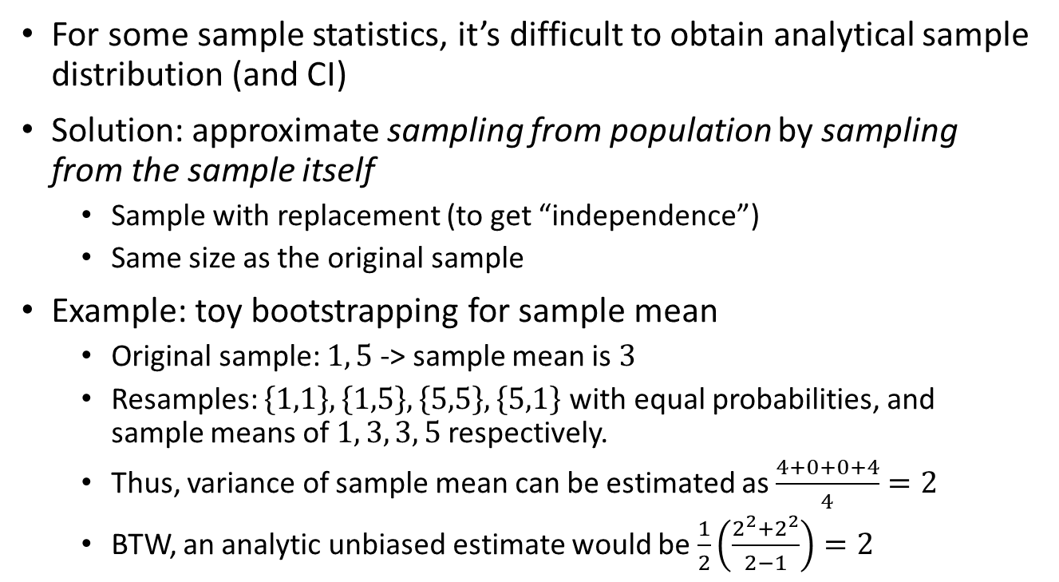
Bootstrapping (a-parametric)

Slide 36
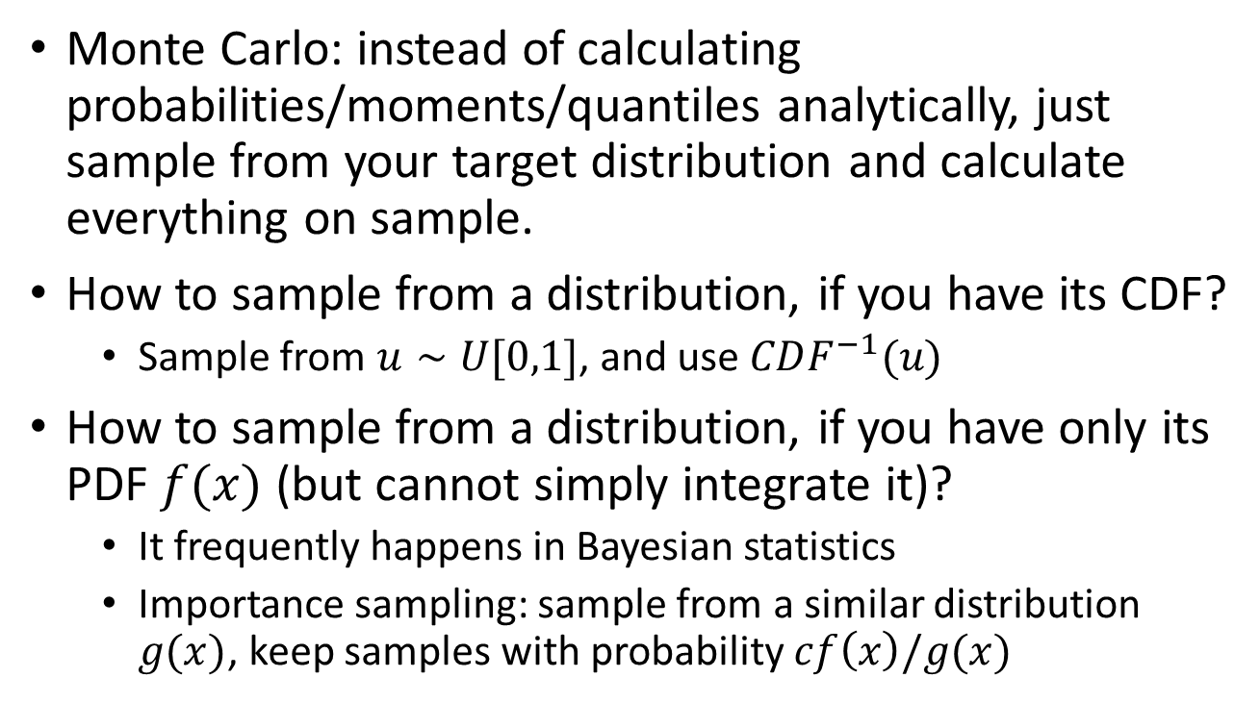
Monte Carlo sampling

Slide 37
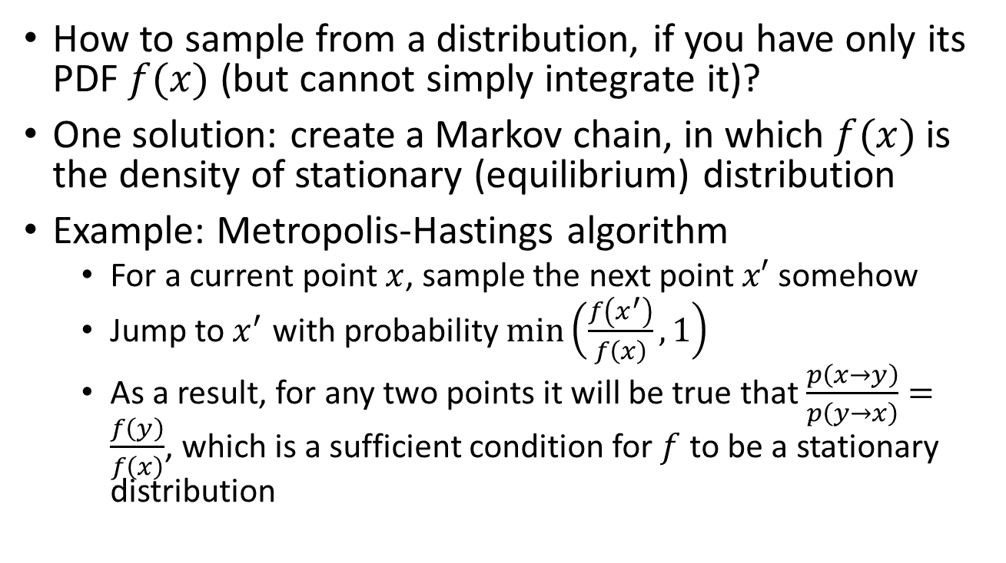
Markov chain Monte Carlo

Slide 38
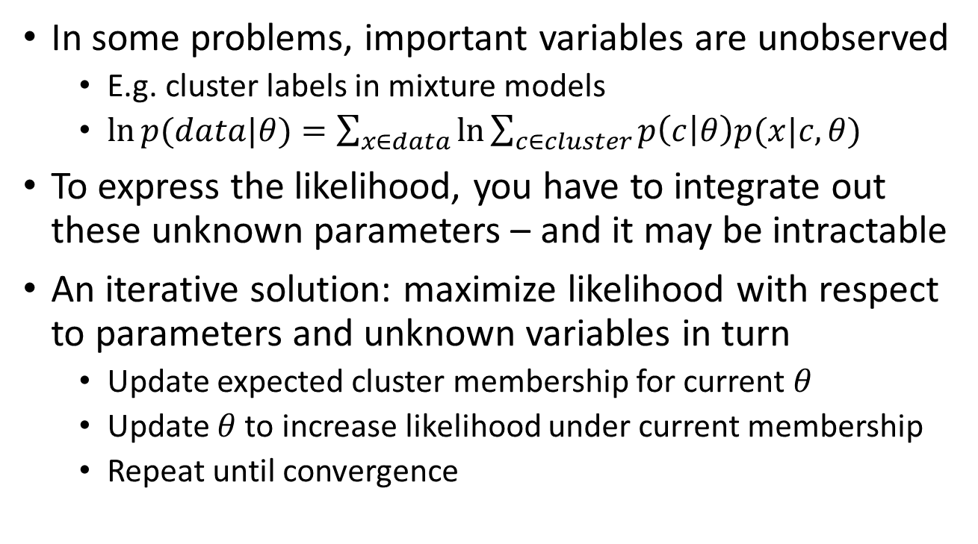
EM algorithm

Slide 39
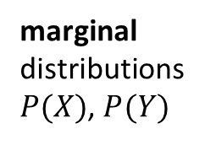
Entropy

Slide 40
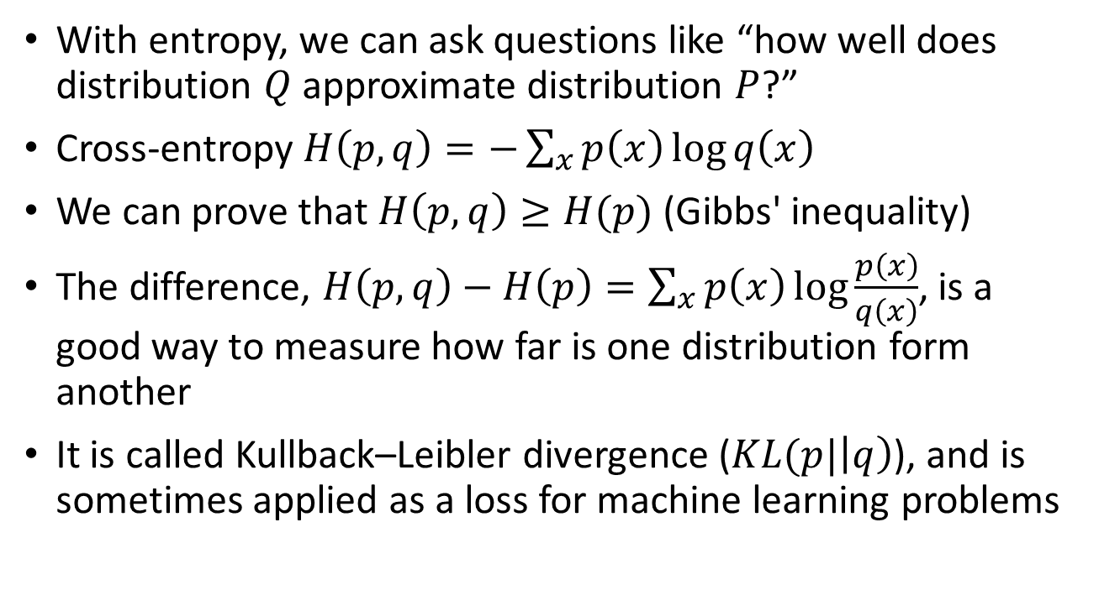
Cross entropy and KL divergence

Slide 41
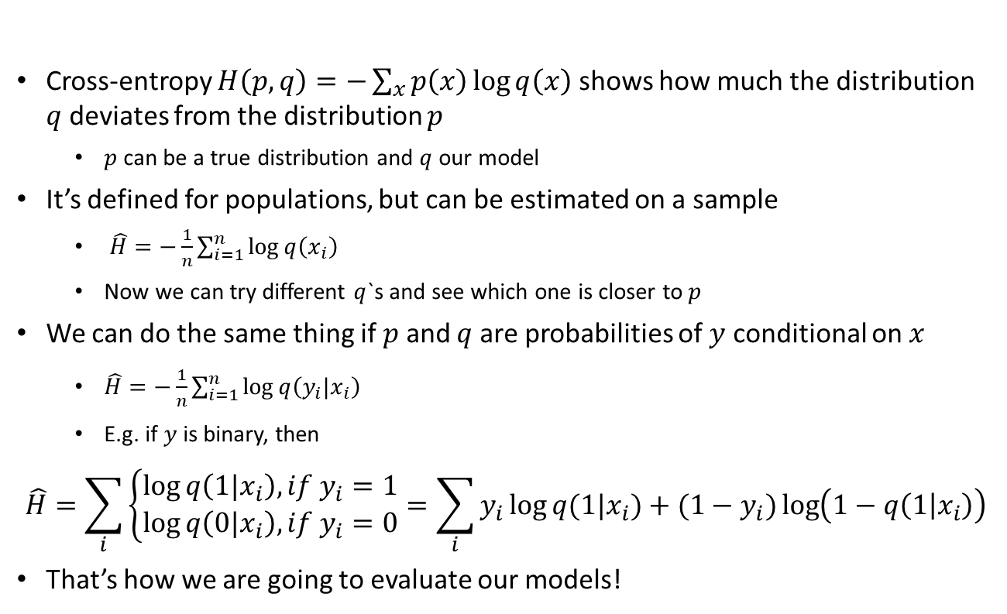
Cross-entropy as a loss function

Slide 42
Principle of maximal entropy
If we tried to “generate” distributions by randomly allocating “quanta” of probability between values, then the distribution with highest entropy would be the most probable
If entropy-increasing transformations are at work out there in the world, then long-term distributions must have maximal entropy
If you know nothing, don’t make informative assumptions
If you are not sure, choose the distribution with the highest entropy for your model!

Slide 43
High-entropy distributions
Assumptions | Maximum entropy distribution
 | discrete univariate
 | univariate
 | geometric
 | exponential
 | normal
 | Pareto

Slide 44
Conclusions

Slide 45
Summary
When we estimate parameters from random samples, they are random as well.
But we know about this randomness a lot.
Maximum likelihood is a general framework for fitting parameters of almost any probabilistic model
Combining MLE with prior information can make parameter estimates more robust

Slide 46
What to do next
5 more problems to solve
Due in 2 weeks
One more Python notebook to click through
Recommended reading:
A Modern Introduction to Probability and Statistics by F.M. Dekking - chapters 17-24
Probability and Statistics in Data Science using Python course on EDX – topic 11

